Slide 1
CSE 545 F2020, Week 6 Stack vulnerabilities: II
Tiffany Bao tbao@asu.edu

Slide 2
Overview
Ctn. Stack overflow: Shellcode
Modern Defense
Stack Canary
ASLR
W ^ X
Return Oriented Programming

Slide 3
Stack Overflow + Shellcode

Slide 4
void record(){
…
}
int check(char *id){
char path[50] = {};
sprintf(path, "records/%s", id);
return(access(path, F_OK) != -1);
}
…
char path[50]
…
int res
saved rbp
saved rip (return address)
…
rsp ->
Overwrite
rbp ->
rbp + 8 ->
record()

Slide 5
void record(){
…
}
int check(char *id){
char path[50] = {};
sprintf(path, "records/%s", id);
return(access(path, F_OK) != -1);
}
…
char path[50]
…
int res
saved rbp
saved rip (return address)
…
rsp ->
Overwrite
shellcode
rbp ->
rbp + 8 ->
&path

Slide 6
Shellcode
Instructions you hope to execute.
What do you wanna execute?

Slide 7
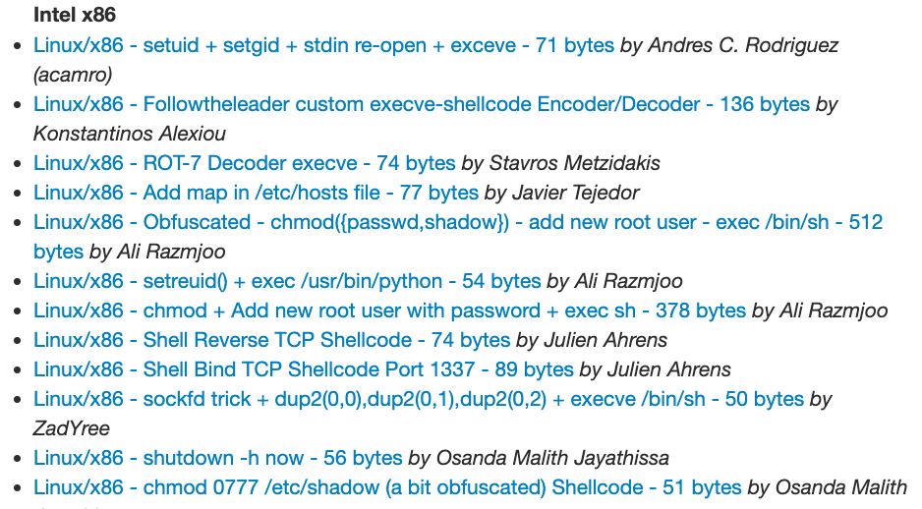
http://shell-storm.org/shellcode/
Notes:
different purpose

Slide 8
A common one
”get the shell”: execute /bin/sh
so that attacker can act as if operating on the victim machine with a shell
or other purpose: e.g., read a secret file

Slide 9
Why are there so many kinds of shellcode?
There may be special conditions on the inputs
e.g., no ‘\n’, no ‘\0’, readable, etc.
The buffer is not long enough.

Slide 10
void record(){
…
}
int check(char *id){
char path[50] = {};
sprintf(path, "records/%s", id);
[code]
return(access(path, F_OK) != -1);
}
<- time of triggering
<- time of exploiting

Slide 11
How to get shellcode
http://shell-storm.org/shellcode/
pwnlib.shellcraft: https://docs.pwntools.com/en/stable/shellcraft.html
Write your own shellcode!

Slide 12
How to write your own shellcode
write disassembly, and compile it
or write source code, and compile it
get the disassembly by objdump
objdump -d [binary]

Slide 13
Compile Disassembly: method 1
section .data ; initialized variable
message: db 'Hello world!'
section .bss ; uninitialized variable
filename: resb 255 ; Reserve 255 bytes
section .text ; Code goes here
global _start
_start:
mov edx, $message
nasm -felf64 example.s -o example

Slide 14
compile disassembly: method 2
.global _start
_start:
.intel_syntax noprefix
mov rdx, message
message:
.string "abc"
gcc -nostdlib -static ./example.s

Slide 15
demo
Notes:
gcc -fno-stack-protector -z execstack ./vuln.c -o vuln
echo 0 | sudo tee /proc/sys/kernel/randomize_va_space

Slide 16
Stack Defense

Slide 17
Steps of exploitation:
Overflow a buffer
Overwrite a saved return address
Register rip points to shellcode
Execute the shellcode saved in buffer
Can we stop the exploitation in any of the above steps?
HOLD THE STACK

Slide 18
Stack canary
…
Local arguments
canary
saved rbp
saved rip (return address)
…
rsp ->
push rbp
mov rbp, rsp
sub rsp, 64
mov rax, QWORD PTR fs:40
mov QWORD PTR -8[rbp], rax
…
call gets@PLT
mov eax, 0
mov rdx, QWORD PTR -8[rbp]
xor rdx, QWORD PTR fs:40
je .L3
call __stack_chk_fail@PLT
.L3:
leave
ret
rbp - 8 ->
rbp ->
rbp + 8 ->

Slide 19
Stack canary
…
Local arguments
canary
saved rbp
saved rip (return address)
…
rsp ->
push rbp
mov rbp, rsp
sub rsp, 64
mov rax, QWORD PTR fs:40
mov QWORD PTR -8[rbp], rax
…
call gets@PLT
mov eax, 0
mov rdx, QWORD PTR -8[rbp]
xor rdx, QWORD PTR fs:40
je .L3
call __stack_chk_fail@PLT
.L3:
leave
ret
Overwrite
rbp - 8 ->
rbp ->
rbp + 8 ->

Slide 20
Canary value
Random value predefined per thread before main is called
8 bytes in x86-64
The value is stored in stack
Notes:
https://www.elttam.com/blog/playing-with-canaries/#content

Slide 21
pwndbg> info auxv
33 AT_SYSINFO_EHDR System-supplied DSO's ELF header 0x7ffff7ffa000
16 AT_HWCAP Machine-dependent CPU capability hints 0xf8bfbff
6 AT_PAGESZ System page size 4096
17 AT_CLKTCK Frequency of times() 100
3 AT_PHDR Program headers for program 0x400040
4 AT_PHENT Size of program header entry 56
5 AT_PHNUM Number of program headers 9
7 AT_BASE Base address of interpreter 0x7ffff7dd5000
8 AT_FLAGS Flags 0x0
9 AT_ENTRY Entry point of program 0x400540
11 AT_UID Real user ID 1000
12 AT_EUID Effective user ID 1000
13 AT_GID Real group ID 1000
14 AT_EGID Effective group ID 1000
23 AT_SECURE Boolean, was exec setuid-like? 0
AT_RANDOM Address of 16 random bytes 0x7fffffffe0c9
26 AT_HWCAP2 Extension of AT_HWCAP 0x0
31 AT_EXECFN File name of executable 0x7fffffffefc9 "/mnt/hgfs/CSE545-F20/Codes/Week 6/canary/a.out"
15 AT_PLATFORM String identifying platform 0x7fffffffe0d9 "x86_64"
0 AT_NULL End of vector 0x0

Slide 22
$ od -t d8 /proc/[pid]/auxv
0000000 33 140737354113024
0000020 16 260832255
0000040 6 4096
0000060 17 100
0000100 3 93824992231488
0000120 4 56
0000140 5 9
0000160 7 140737351864320
0000200 8 0
0000220 9 93824992244096
0000240 11 1000
0000260 12 1000
0000300 13 1000
0000320 14 1000
0000340 23 0
0000360 25 140737488347417
0000400 26 0
0000420 31 140737488351212
0000440 15 140737488347433
0000460 0 0

Slide 23
Canary value
Random value predefined per thread before main is called
8 bytes in x86-64
The value is stored in stack
The last byte of the canary is equal to \x00
pwndbg> x/g 0x7fffffffe0c9
0x7fffffffe0c9: 0x010e6cac58bda382
pwndbg> p/x $rax
$1 = 0x10e6cac58bda300
Notes:
https://www.elttam.com/blog/playing-with-canaries/#content

Slide 24
Bypassing Stack Canary
The below approaches may work for stack canary
Leak the canary value
Override the predefined canary stored in stack
Hijack __stack_chk_fail function

Slide 25
Leak the canary value
…
buf
deadbeefdeadbe00
saved rbp
saved rip (return address)
…
rsp ->
Overwrite
void vuln() {
char buf[100];
for(int i=0; i<2;i++) {
gets(buf);
printf(buf);
}
}
rbp - 8 ->
rbp ->
rbp + 8 ->

Slide 26
Overwrite predefined canary
…
buf
deadbeefdeadbe00
saved rbp
saved rip (return address)
…
Predefined canary
…
rsp ->
Overwrite
void vuln() {
char buf[100];
for(int i=0; i<2;i++) {
gets(buf);
printf(buf);
}
}
rbp - 8 ->
rbp ->
rbp + 8 ->

Slide 27
Hijack __stack_chk_fail
change the .plt or the .got.plt table
usually requires other vulnerability

Slide 28
Steps of exploitation:
Overflow a buffer
Overwrite a saved return address
Register rip points to shellcode
Execute the shellcode saved in buffer
Can we stop the exploitation in any of the above steps?
HOLD THE STACK
stack canary
ASLR

Slide 29
ASLR: Address space layout randomization
…
char path[50]
…
int res
saved rbp
saved rip (return address)
…
rsp ->
Overwrite
Address is Randomized
shellcode
rbp ->
rbp + 8 ->
&path

Slide 30
jmp *rsp: bypass aslr
…
saved rbp
saved rip (return address)
…
low address
void foo(){
int x = 0;
int y = 1;
printf(”%d\n”, x + y);
}
void bar(){
foo();
printf(”bye\n”);
}
<+182>: leave
<+183>: ret
Overwrite
rip
rsp ->
high address
rbp ->

Slide 31
jmp *rsp: bypass aslr
…
saved rbp
saved rip (return address)
…
low address
void foo(){
int x = 0;
int y = 1;
printf(”%d\n”, x + y);
}
void bar(){
foo();
printf(”bye\n”);
}
jmp *rsp
Overwrite
rsp ->
high address
rbp ->

Slide 32
jmp *rsp: bypass aslr
…
saved rbp
saved rip (return address)
…
low address
void foo(){
int x = 0;
int y = 1;
printf(”%d\n”, x + y);
}
void bar(){
foo();
printf(”bye\n”);
}
jmp *rsp
Overwrite
rsp ->
high address
shellcode
rbp ->

Slide 33
DEMO

Slide 34
Steps of exploitation:
Overflow a buffer
Overwrite a saved return address
Register rip points to shellcode
Execute the shellcode saved in buffer
Can we stop the exploitation in any of the above steps?
HOLD THE STACK
stack canary
ASLR
W^X

Slide 35
W^X: write xor execute
A memory page is either writable or executable, not both.
Windows: DEP (Data Execution Prevention)
NX bit: no-execute bit in CPU

Slide 36
How to Bypass W^X?
It’s challenging, but still doable!

Slide 37
How to Bypass W^X?
It’s challenging, but still doable!
To Be Cont’d

Slide 38
How to avoid stack overflow
Use more secure functions
strcpy -> strncpy
strcat -> strncat
gets -> fgets
sprintf -> snprintf
memcpy: pay attention to the size argument
Check source argument size

Slide 39
checking binary security setup
$ checksec /bin/ls
[*] '/bin/ls'
Arch: amd64-64-little
RELRO: Full RELRO
Stack: Canary found
NX: NX enabled
PIE: PIE enabled
FORTIFY: Enabled

Slide 40
Turn on/off Security Setup
Security Mechanism | Command
No Stack Canary | gcc -fno-stack-protector
No W^X on Stack | gcc -z execstack
No ASLR | echo 0 | sudo tee /proc/sys/kernel/randomize_va_space (origin value: 2)
No PIE | gcc -no-pie

Slide 41
Stack Overflow + ROP

Slide 42
Steps of exploitation:
Overflow a buffer
Overwrite a saved return address
Register rip points to shellcode
Execute the shellcode saved in buffer
Can we stop the exploitation in any of the above steps?
stack canary
ASLR
W^X

Slide 43
IDEA
No shellcode can be executed
But the code originally in the binary can be executed
Can we (ab)use the code to execute what we want?

Slide 44
ROP: Return-oriented programming
Idea: To overwrite the returned rip to point to somewhere in code segment

Slide 45
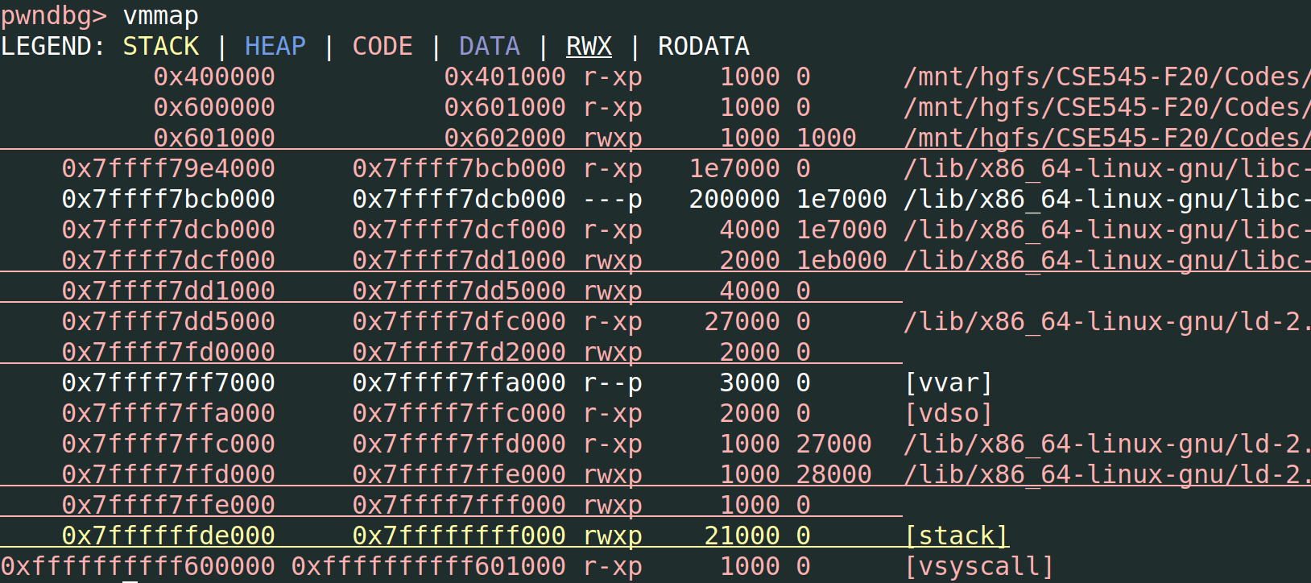

Slide 46
ROP: Return-oriented programming
Idea: To overwrite the returned rip to point to somewhere in code segment
…but it’s very likely that there is no sequence of code doing exactly what we want.

Slide 47
ROP: Return-oriented programming
Idea: To overwrite the returned rip to point to somewhere in code segment
…but it’s very likely that there is no sequence of code doing exactly what we want.
ROP chain: cut code into small pieces and chain them up

Slide 48
RET
low address
low address
…
saved rbp
saved rip (return address)
…
…
saved rbp
saved rip (return address)
…
rsp ->
rip
rsp ->
rbp ->
rbp ->
high address
high address
Before RET
After RET

Slide 49
RET + RET
low address
…
saved rbp
saved rip (return address)
…
…
saved rbp
saved rip (return address)
…
…
saved rbp
saved rip (return address)
saved rip2 (return address)
…
RET
RET
rsp ->
rsp ->
rsp ->
rbp ->
rbp ->
rbp ->
high address

Slide 50
RET + RET
mov rdi, [”hello”]
ret
…
low address
…
saved rbp
saved rip (return address)
saved rip2 (return address)
…
call printf
rsp ->
Code in memory
rbp ->
high address

Slide 51
Example
low address
…
saved rbp
saved rip (return address)
saved rip2 (return address)
…
Overwrite
execve("/bin/sh",NULL,NULL)
rax: 0x3b
rdi: char * “/bin/sh”
rsi: 0
rdx: 0
rsp ->
rbp ->
high address

Slide 52
Example
…
“bin/sh”
saved rbp
&pop_rax
0x3b
&pop_rdi
&”/bin/sh”
&mov_rsi_0
&mov_rdx_0
&syscall
…
low address
execve("/bin/sh",NULL,NULL)
pop rax
ret
rsp ->
rax: 0x3b
rdi: &“/bin/sh”
rsi: 0
rdx: 0
rbp ->
high address

Slide 53
Example
…
“bin/sh”
saved rbp
&pop_rax
0x3b
&pop_rdi
&”/bin/sh”
&mov_rsi_0
&mov_rdx_0
&syscall
…
low address
execve("/bin/sh",NULL,NULL)
pop rax
ret
rax: 0x3b
rdi: &“/bin/sh”
rsi: 0
rdx: 0
rsp ->
rbp ->
high address

Slide 54
Example
…
“bin/sh”
saved rbp
&pop_rax
0x3b
&pop_rdi
&”/bin/sh”
&mov_rsi_0
&mov_rdx_0
&syscall
…
low address
execve("/bin/sh",NULL,NULL)
pop rax
ret
rax: 0x3b
rdi: &“/bin/sh”
rsi: 0
rdx: 0
rsp ->
pop rdi
ret
rbp ->
high address

Slide 55
Tool
ROPgadget: https://github.com/JonathanSalwan/ROPgadget
ropium: https://github.com/Boyan-MILANOV/ropium
ROP can be very creative and fun!

Slide 56
demo?
In-class Lab

Slide 57
in-class Lab

Slide 58
Announcement
No Class Next Week

Slide 59
Announcement
Assignment 3 will be released next week
The grade of assignment 1 & 2 will be released next week

Slide 60
In-class Lab
nc asu-cse545.com 6666
Binaries:
https://www.tiffanybao.com//courses/cse545/labs/week6/stack
https://www.tiffanybao.com//courses/cse545/labs/week6/libc-2.31.so
https://www.tiffanybao.com//courses/cse545/labs/week6/ld-2.31.so
Run the binary locally:
LD_PRELOAD=“[path of ld-2.31.so] [path of libc-2.31.so]” ./stack
Debug the binary in gdb:
set env LD_PRELOAD = [path of ld-2.31.so] [path of libc-2.31.so]

